Slide 1
Chapter 1.3
Macro Processors
1

Slide 2
Introduction to Macro Processors
A macro instruction (macro) is a notational convenience for the programmer.
Allow the programmer to write a shorthand version of a program
A macro represents a commonly used group of statements in the source programming language.
Expanding the macros
The macro processor replaces each macro instruction with the corresponding group of source language statements.
2

Slide 3
Introduction to Macro Processors (Cont.)
A macro processor
Essentially involve the substitution of one group of characters or lines for another.
Normally, it performs no analysis of the text it handles.
It doesn’t concern the meaning of the involved statements during macro expansion
The design of a macro processor generally is machine independent.
3

Slide 4
Introduction to Macro Processors (Cont.)
Three examples of actual macro processors:
A macro processor designed for use by assembler language programmers
Used with a high-level programming language
General-purpose macro processor, which is not tied to any particular language
Source Code
(with macro)
Macro Processor
Expanded
Compiler
/Assembler
Object program
Code
4

Slide 5
Introduction to Macro Processors (Cont.)
□ C uses a macro preprocessor to support language extensions, such as named constants, expressions, and file inclusion.
#define max(a,b) ((a<b)?(a):(b)) #define MACBUF 4
#include <stdio.h>
5

Slide 6
Macro Processor
Salient features of Macro Processor:
Macro Processor replaces each macro instruction with the corresponding group of source language statements. This is known as the expansion of macros.
Using Macro instructions, programmer can leave the mechanical details to be handled by the macro processor.
Macro Processor designs are not directly related to the computer architecture on which it runs.
Macro Processor involves definition, invocation, and expansion.

Slide 7
4.1 Basic Macro Processors Functions
Macro processor should processes the
Macro definitions
Define macro name, group of instructions
Macro invocation (macro calls)
A body is simply copied or substituted at the point of call
Expansion with substitution of parameters
Arguments are textually substituted for the parameters
The resulting procedure body is textually substituted for the call
7

Slide 8
Macro Definition
Two new assembler directives are used in macro definition:
MACRO: identify the beginning of a macro definition
MEND: identify the end of a macro definition
op operands
MACRO parameters
:
body
:
MEND
□ label
name
Parameters: the entries in the operand field identify the parameters of the macro instruction
We require each parameter begins with ‘&’
Body: the statements that will be generated as the expansion of the macro.
Prototype for the macro:
The macro name and parameters define a pattern or prototype for the macro
instructions used by the programmer
8

Slide 9
Macro Definition ,call & expansion
The MACRO statement identifies the beginning of a macro definition
The symbol in the label field is the name of the instruction
The entries in the operand field identify the parameter of the macro instruction
Each parameter begins with the character &
The MEND assembler directive marks the end of the macro definition
A macro invocation statement gives the name of the macro instruction being invoked and the arguments to be used in expanding the macro.

Slide 10
Macro Definition ,call & expansion (Contd..)
Macro Definition and Expansion:
Line Label Opcode Operand
5 COPY START 0
10 RDBUFF MACRO &INDEV, &BUFADR
15
. .
90
95 MEND
Line 10: - RDBUFF (Read Buffer) in the Label part is the name of the Macro or definition of the Macro. &INDEV and &BUFADR are the parameters present in the Operand part. Each parameter begins with the character &.
Line 15 – Line 90: - From Line 15 to Line 90 Macro Body is present. Macro directives are the statements that make up the body of the macro definition.
Line 95: MEND is the assembler directive that means the end of the macro definition.

Slide 11
Macro Invocation:
Line Label Opcode Operand
180 FIRST STL RETADR
190 CLOOP RDBUFF F1, BUFFER
15
. .
255 END FIRST
Line 190:
RDBUFF is the Macro invocation or Macro Call that gives the name of the macro instruction being invoked
F1, BUFFER are the arguments to be used in expanding the macro.
The statement that form the expansion of a macro are generated each time the macro is invoked.

Slide 12
Copy code -- Example
Source
STRG MACRO
STA DATA1
STB DATA2
STX DATA3
MEND
.
STRG
.
STRG
.
.
Expanded source
.
.
.
STA DATA1
STB DATA2
STX DATA3
.
STA DATA1
STB DATA2
STX DATA3
.
{
{

Slide 13
Parameter Substitution -- Example
Source
STRG MACRO &a1, &a2, &a3
STA &a1
STB &a2
STX &a3
MEND
.
STRG DATA1, DATA2, DATA3
.
STRG DATA4, DATA5, DATA6
.
.
Expanded souce
.
.
.
STA DATA1
STB DATA2
STX DATA3
.
STA DATA4
STB DATA5
STX DATA6
.
{
{

Slide 14
Parameter Substitution
Dummy arguments
Positional argument
STRG DATA1, DATA2, DATA3 means &a1=DATA1, &a2=DATA2, &a3=DATA3
Keyword argument
STRG &a3=DATA1, &a2=DATA2, &a1=DATA3
STRG &a3=&a2=DATA2, &a1=DATA3

Slide 15
Macro Invocation
A macro invocation statement (a macro call) gives the name of the macro instruction being invoked and the arguments in expanding the macro.
Macro Invocation vs. Subroutine Call.
Statements of the macro body are expanded each time the macro is invoked.
Statements of the subroutine appear only one, regardless of how many times the subroutine is called.
Macro invocation is more efficient than subroutine call, however, the code size is larger

Slide 16
Macro Expansion
Each macro invocation statement will be expanded into the statements that form the body of the macro.
Arguments from the macro invocation are
substituted for the parameters in the macro prototype.
The arguments and parameters are associated with one another according to their positions.
□ The first argument in the macro invocation corresponds to the first parameter in the macro prototype, etc.

Slide 17
Macro Expansion
Expanded source program
.
.
.
Source program
Macro definition
WD MACRO
STA DATA1
STB DATA2 MEND
STA DATA1
STB DATA2
.
STA DATA1
STB DATA2
.
STA DATA1
STB DATA2
.
Macro Expansion by
Macro processor
.
WD
.
WD
.
WD
Macro invocation
.
14

Slide 18
Macro Expansion with Parameters Substitution
Source program
Macro definition
Expanded source program
.
.
WD MACRO &A1,&A2
STA &A1
STB &A2 MEND
STA DATA1
STB DATA2
.
STA DATA3
STB DATA4
.
STA DATA5
STB DATA6
.
Macro Expansion by
Macro processor
.
WD DATA1,DATA2
.
WD DATA3,DATA4
.
WD DATA5,DATA6
.
Macro invocation
15

Slide 19
No Label in the Body of Macro
Problem of the label in the body of macro:
If the same macro is expanded multiple times at different places in the program.
There will be duplicate labels, which will be treated as errors by the assembler,
Solutions:
Simply not to use labels in the body of macro.
Explicitly use PC-relative addressing instead.
For example, in RDBUFF and WRBUFF macros,
JEQ JLT
* +11
*-14
□ It is inconvenient and error-prone.
Other better solution?
□ Mentioned in Section 4.2.2.

Slide 20
4.1.2 Macro Processors Algorithm and Data Structures
Two-pass macro processor
One-pass macro processor

Slide 21
Two-pass macro processor
Two-pass macro processor
Pass1: process all macro definitions
Pass2: expand all macro invocation statements
Problem
Does not allow nested macro definitions
Nested macro definitions
□ The body of a macro contains definitions of other macros
Because all macros would have to be defined during the first pass before any macro invocations were expanded
Solution
One-pass macro processor

Slide 22
One-pass macro processor
One-pass macro processor
One-pass processor can alternate between macro definition and macro expansion
Nested macro definitions are allowed

Slide 23
Three Main Data Structures
DEFTAB
A definition table used to store macro definition including
macro prototype
macro body
Comment lines are omitted.
Positional notation has been used for the parameters for efficiency in substituting arguments.
E.g. the first parameter &INDEV has been converted to ?1 (indicating the first parameter in the prototype)
NAMTAB
A name table used to store the macro names
Serves as an index to DEFTAB
Pointers to the beginning and the end of the macro definition
ARGTAB
A argument table used to store the arguments used in the expansion of macro invocation
As the macro is expanded, arguments are substituted for the corresponding parameters in the macro body.
27

Slide 24
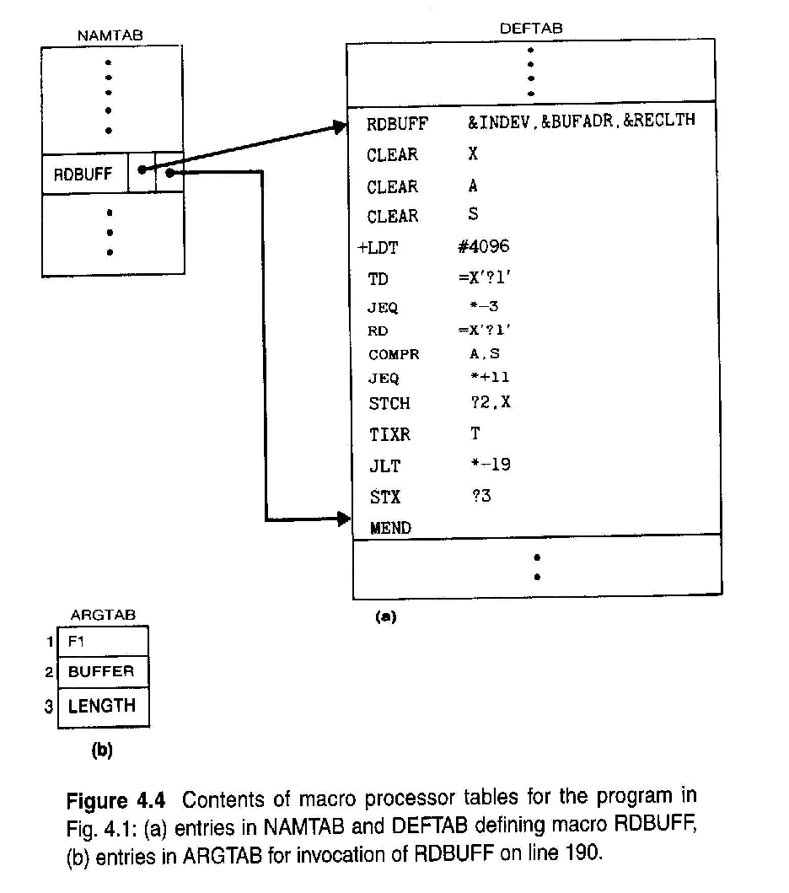

Slide 25
One-Pass Macro Processor
Prerequisite
every macro must be defined before it is called
Sub-procedures
macro definition: DEFINE
macro invocation: EXPAND
NAMTAB
MACRO
DEFINE
DEFTAB
PROCESSLINE
ARGTAB
CALL
EXPAND

Slide 26
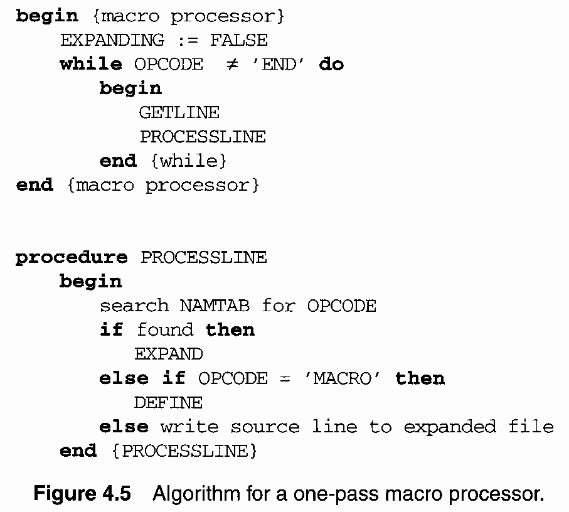

Slide 27
Explanation of algorithm
The algorithm uses 5 procedures
MACROPROCESSOR (main function)
DEFINE
EXPAND
PROCESSLINE
GETLINE

Slide 28
MACROPROCESSOR (MAIN function)
•This function initialize the variable named EXPANDING to false.
•It then calls GETLINE procedure to get next line from the source program and PROCESSLINE procedure to process that line.
PROCESSLINE
•This procedure checks
oIf the opcode of current statement is present in NAMTAB. If so it is a macro invocation statement and calls the procedure EXPAND

Slide 29
DEFINE
•The control will reach in this procedure if and only if it is identified as a macro definition statement.Then:
oMacro name is entered into NAMTAB
oThen the macro name along with its parameters are entered into DEFTAB.
EXPAND
•The control will reach in this procedure if and only if it is identified as a macro call.
•In this procedure, the variable EXPANDING is set to true. It actually indicates the GETLINE procedure that it is going to expand the macro call. So that GETLINE procedure will read the next line from DEFTAB instead of reading from input file.

Slide 30
GETLINE
•This procedure is used to get the next line.
•If EXPANDING = TRUE, the next line is fetched from DEFTAB. (It means we are expanding the macro call)
•If EXPANDING = False, the next line is read from input file.

Slide 31
One-Pass Macro Processor Allows Nested Macro Definition
Sub-procedure DEFINE should handle the nested macro definition
Maintains a counter named LEVEL
Each time a MACRO directive is read, the value of LEVEL is increased by 1
Each time an MEND directive is read, the value of LEVEL is decreased by 1

Slide 32
Nested Macros Definition
Macro definition within macros
process inner macro definition, during the expansion of outer macro
Outer macro definition
Inner macro definition

Slide 33
Nested Macro Definition
Example
TEST START 2000h
MACROS MACRO
CELTOFER MACRO &CEL &FER
LDA &CEL
MULT NINE
DIV FIVE
ADD THIRTYTWO
STA &FER
MEND
MEND
MACROF MACRO
CELTOFER MACRO &CEL &FER
LDAF &CEL
MULTF NINE
DIVF FIVE
ADDF THIRTYTWO
STAF &FER
MEND
MEND
Integer instructions set
Floating point instructions set

Slide 34
Nested Macro Definition Example
MACROS
CELTOFER C F
C RESW 1
F RESW 1
NINE WORD 9
FIVE WORD 5
THIRYTWO WORD 32
MACROF
CELTOFER C F
C RESW 1
F RESW 1
NINE WORD 9
FIVE WORD 5
THIRYTWO WORD 32 END

Slide 35
One-Pass Macro Processor That Allows Nested Macro Definition
Sub-procedures
macro definition: DEFINE
macro invocation: EXPAND
EXPAND may invoke DEFINE when encounter macro definition
NAMTAB
DEFINE
MACRO
DEFTAB
PROCESSLINE
CALL
EXPAND
ARGTAB
Expanding
MACRO Definition

Slide 36
ARGTAB
DEFTAB
MACRO Definition
DEFINE
NAMTAB
GETLINE
PROCESSLINE
Macro Invocation
EXPAND
ARGTAB

Slide 37
1-Pass Macro Processor

Slide 38
Comparison of Macro Processors Design
Single pass
every macro must be defined before it is called
one-pass processor can alternate between macro definition and macro expansion
nested macro definitions may be allowed but nested calls are not
Two pass algorithm
Pass1: Recognize macro definitions
Pass2: Recognize macro calls
nested macro definitions are not allowed

